Slide 1

Note: The data and information in this document is reflective of a hypothetical situation and client. This document is to be used for KPMG Virtual Internship purposes only.
Sprocket Central Pty Ltd
Data analytics approach
[Division Name] - [Engagement Manager], [Senior Consultant], [Junior Consultant]

Slide 2
Note: The data and information in this document is reflective of a hypothetical situation and client. This document is to be used for KPMG Virtual Internship purposes only.
Agenda
Introduction
Data Exploration
Discover distributions and features of previous & new customers
Model Development
Customer classification to target high value customers
Interpretation
Marketing strategies based on customer characteristics

Slide 3
Note: The data and information in this document is reflective of a hypothetical situation and client. This document is to be used for KPMG Virtual Internship purposes only.
Introduction
Customer analysis
The following features are used in previous & new customer analysis:
Age & gender distribution
Job industry category distribution
Wealth segments distribution
Number of bike related purchases in 3 years
Number of car owners in different states

Slide 4
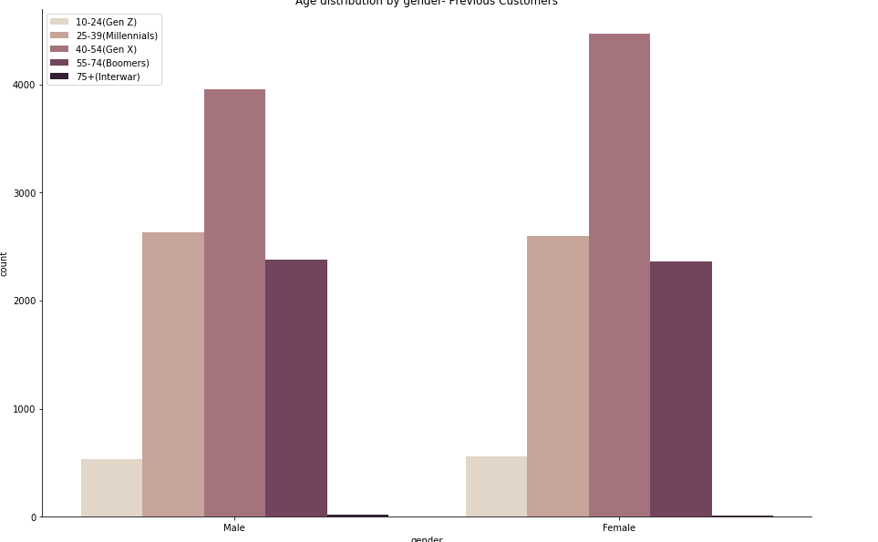
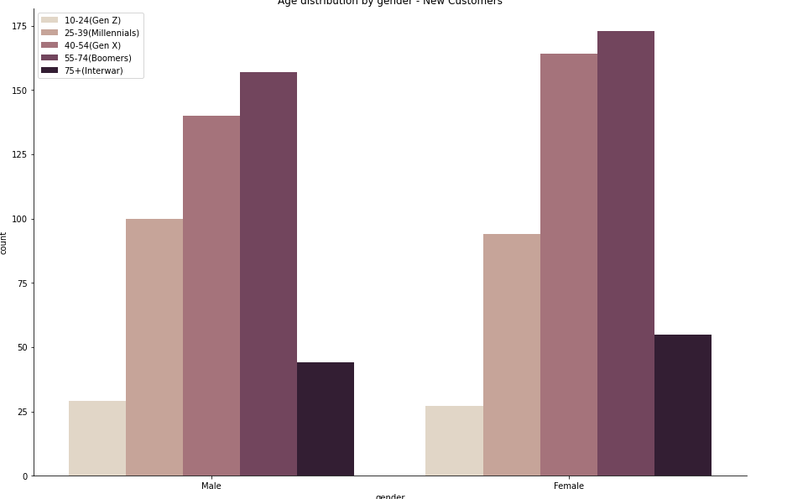
Note: The data and information in this document is reflective of a hypothetical situation and client. This document is to be used for KPMG Virtual Internship purposes only.
Data Exploration – Age & gender distribution
Previous customers
New customers
Previous customers:
Age 40 – 54 (Gen X) with more females (1st)
Age 25 – 39 (Millennials) with similar shares of male vs. female (2nd)
Age 55 – 74 (Boomers) with similar shares of male vs. female (3rd)
New customers:
Age 55 – 74 (Boomers) with more females (1st)
Age 40 – 54 (Gen X) with more females (2nd)
Age 25 – 39 (Millennials) with similar shares of male vs. female (3rd)
More from age 55 + compared with previous customers

Slide 5
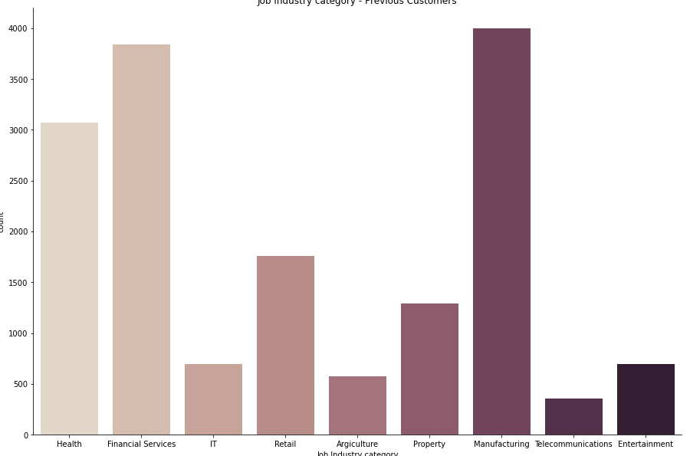
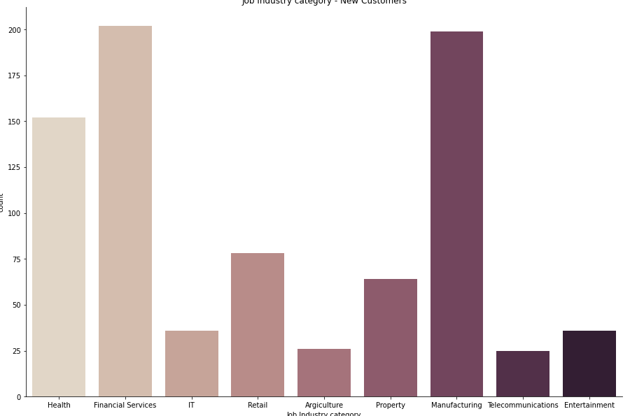
Note: The data and information in this document is reflective of a hypothetical situation and client. This document is to be used for KPMG Virtual Internship purposes only.
Data Exploration - Job industry category distribution
Previous customers
New customers
Previous customers: top 3 industry profiles from Manufacturing (1st), Financial Services (2nd), Health (3rd)
New customers: top 3 industry profiles from Financial Services (1st), Manufacturing (2nd), Health (3rd)
Overall similar customer industry profiles between previous and new customers

Slide 6
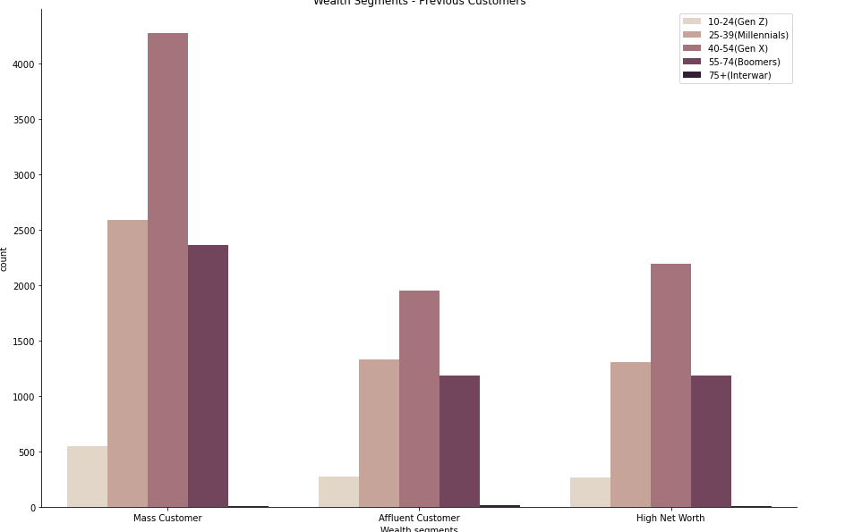
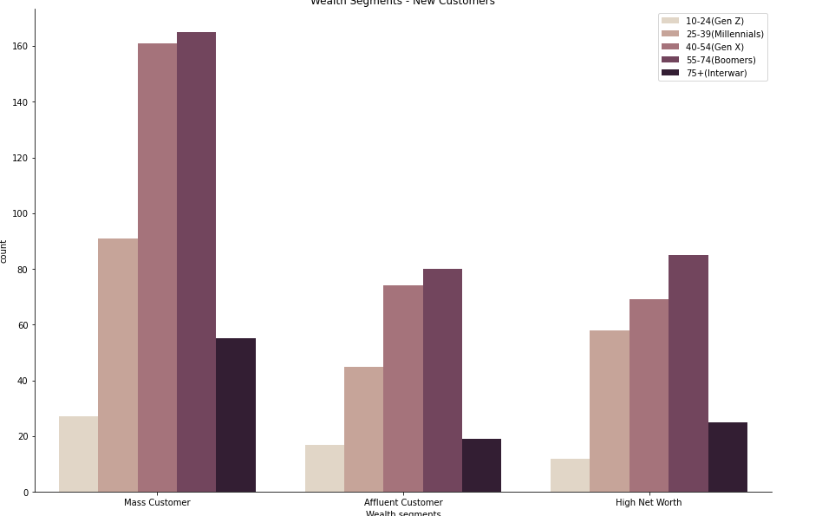
Note: The data and information in this document is reflective of a hypothetical situation and client. This document is to be used for KPMG Virtual Internship purposes only.
Data Exploration - Wealth segments distribution
Previous customers
New customers
Most customers from Mass Customer group in both previous & new customers
More new customers from Age 55+ in all wealth segments compared to previous customers

Slide 7
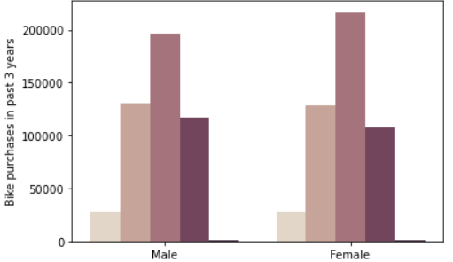
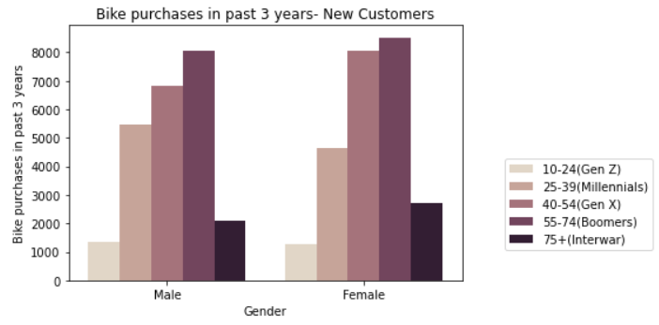
Note: The data and information in this document is reflective of a hypothetical situation and client. This document is to be used for KPMG Virtual Internship purposes only.
Data Exploration - Number of bike related purchases in 3 years
Previous customers
New customers
Age 40 – 54 (Gen X) group in previous customers made highest amount of bike related purchases in the past 3 years. Females in this group made more purchases than males.
Age 40 – 54 (Gen X) group in new customers still made high amount of bike related purchases in the past 3 years with more female vs. males.
Age 55+ groups in new customers made significant more bike related purchases in the past 3 years compared to previous customers. Females in these groups also made more purchases than males. Could be emerging market.

Slide 8
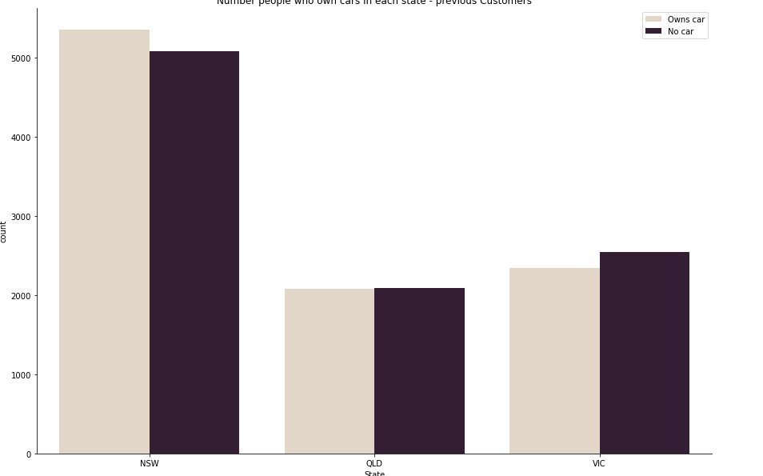
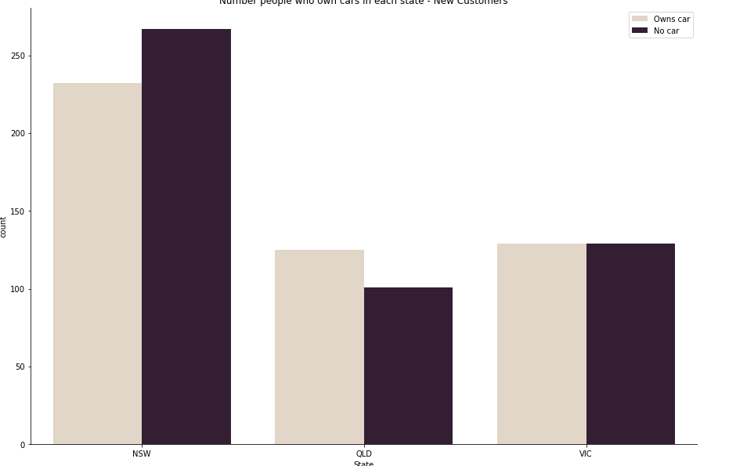
Note: The data and information in this document is reflective of a hypothetical situation and client. This document is to be used for KPMG Virtual Internship purposes only.
Data Exploration - Number of car owners in different states
Previous customers
New customers
More new customers living in New South Wales (NSW) don’t own cars. NSW could be primary market.
Most previous customers living in NSW compared to QLD and VIC.
New customers have more car owners living in QLD vs. people without cars in new customers. Relatively equal proportion car owners vs. people without cars in VIC.

Slide 9
Note: The data and information in this document is reflective of a hypothetical situation and client. This document is to be used for KPMG Virtual Internship purposes only.
Model Development - Two target customer groups
High value customers sharing characteristics similar to previous customer groups
New customers’ classification matching the following features:
Age: 40-54 (Gen X)
Female
Working in Manufacturing, Financial Services or Health
Wealth segment in Mass Customer
Living in New South Wales (NSW)

Slide 10
Note: The data and information in this document is reflective of a hypothetical situation and client. This document is to be used for KPMG Virtual Internship purposes only.
Model Development - Two target customer groups
High value customers in emerging customer groups
New customers’ classification matching the following features:
Age: 55+, including 55-74 (Boomers) & 75+ (Interwar)
Female
Working in Manufacturing, Financial Services or Health
Wealth segment in Mass Customer
Living in New South Wales (NSW)

Slide 11
Note: The data and information in this document is reflective of a hypothetical situation and client. This document is to be used for KPMG Virtual Internship purposes only.
Interpretation
Marketing strategies based on different customer groups
Females will be primary target customers
Use female cyclists’ photos and videos in commercials and company’s social media posts
Provide more appearance customization options of bicycles at the stores
Targeted marketing and multi-channel sales process for different age groups
Marketing to age group 40-54 (Gen X) focuses on work-life balance and some tech aspects
Marketing to age group 55+ focuses on easy access, good customer service and personalized experience
Multi-channel sales including online and offline (e.g., physical stores, phone calls and catalogs)
Location-based marketing
Marketing products based on specific need in a state, such as local weather and geographical characters related needs.

Slide 12
Note: The data and information in this document is reflective of a hypothetical situation and client. This document is to be used for KPMG Virtual Internship purposes only.
Appendix

Slide 13
Note: The data and information in this document is reflective of a hypothetical situation and client. This document is to be used for KPMG Virtual Internship purposes only.
Appendix
This is an optional slide where you may place any supporting items.

